Slide 1
Being Brave

Slide 2
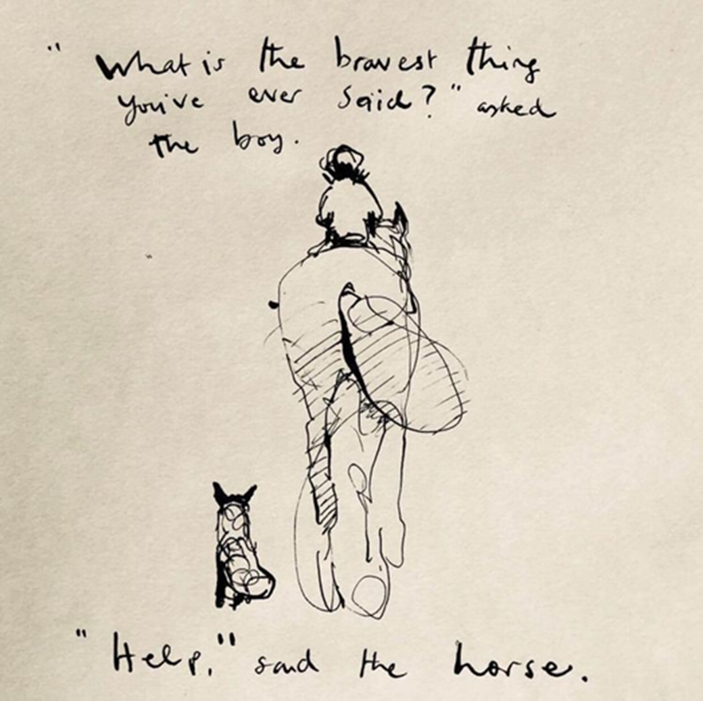
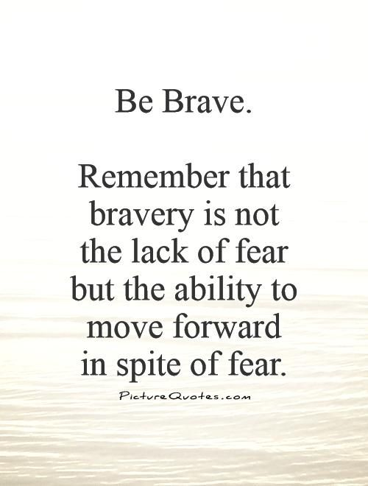
What is bravery?

Slide 3
What is not bravery?
Aggressiveness and bullying
Putting yourself and others at risk for no reason
Doing something that isn’t scary for you
Putting others down – humiliating/shaming them
Being mean on social media or in real life
Taking no responsibility for your actions, lack of action or words
Fight response

Slide 4
What is sometimes bravery?
Assertiveness
Taking risks
Learning – especially when it’s really difficult
Defending others and yourself
Taking responsibility for your actions, lack of action or words
Fighting
Going to work or school
Doing something you are trained to do
Wearing certain clothing or make up
Being yourself and expressing who you are

Slide 5
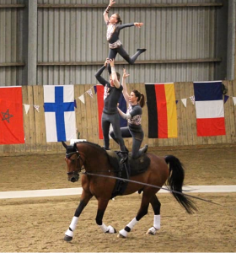
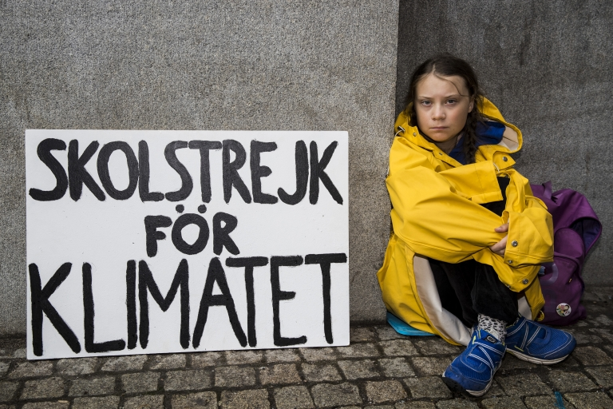
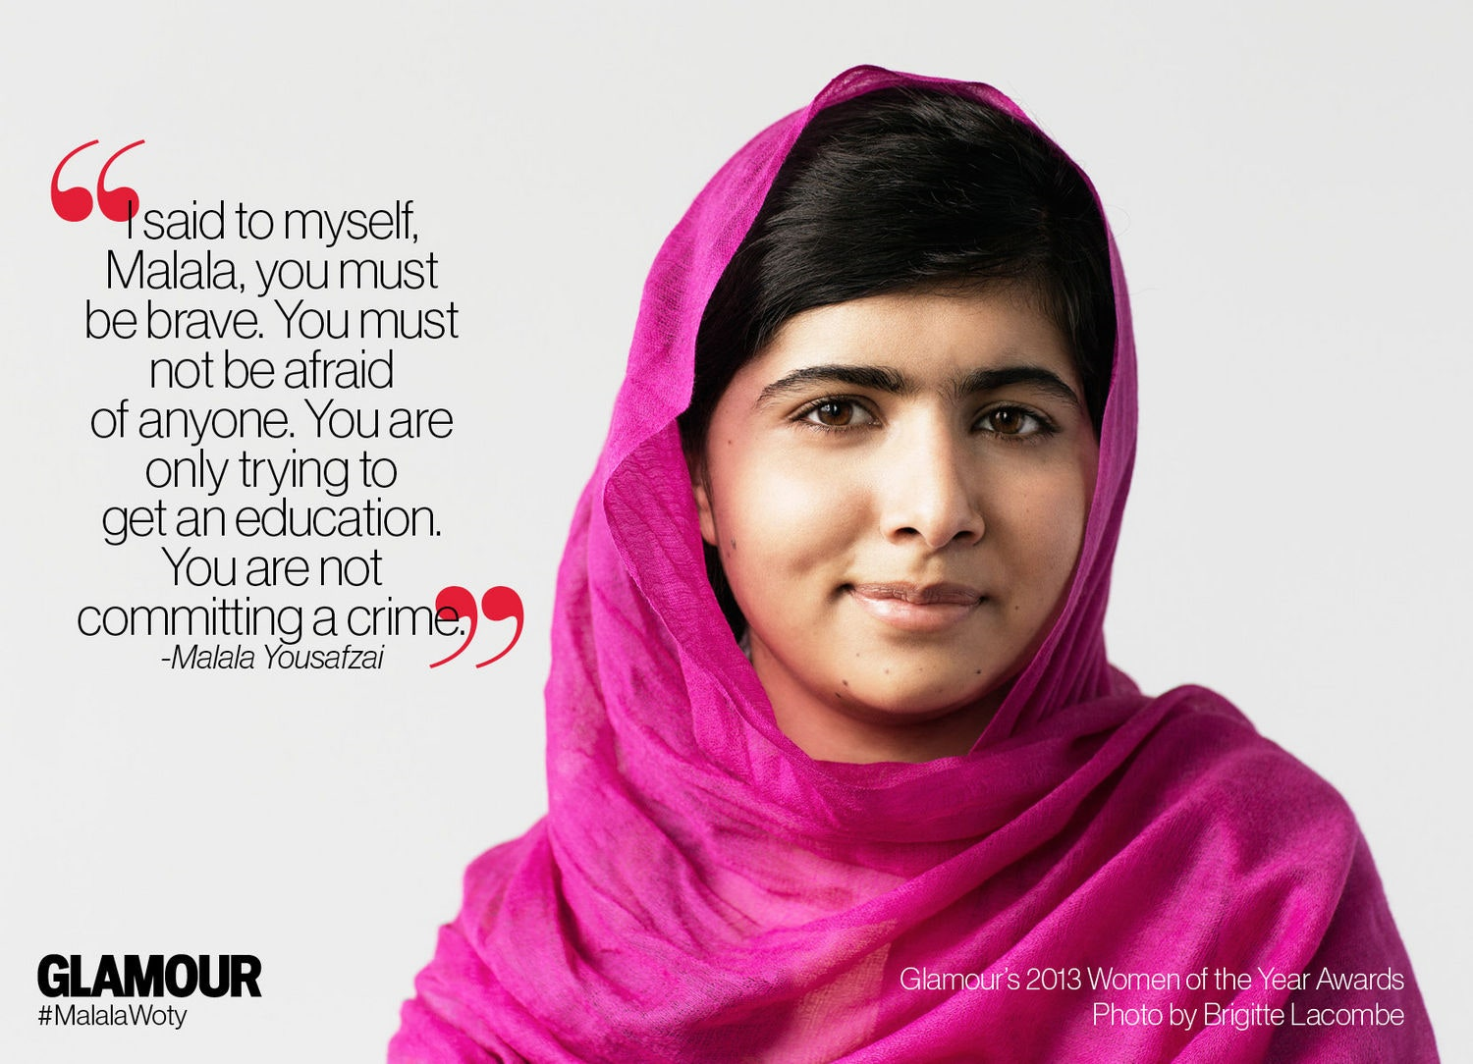
Bravery is learned
We aren’t born brave, we learn how to be brave
We can practice being brave and get better at it
Children practicing being brave can be a challenge for adults

Slide 6
Bravery is learned

Slide 7
Bravery and Vulnerability
Vulnerability allows us to be connected to others, to be creative, have trust, feel shame, to fear, to grieve, to be loved and love, to feel a sense of tenderness and intimacy, for belonging.
Vulnerability is our way to overcome feelings of disconnection with others.
If we numb vulnerability we also numb our ability to feel the painful stuff like grief, disappointment, fear, rejection.
If we numb vulnerability, we don’t allow ourselves to be seen properly and for who we are.
We need to be brave to allow ourselves to be vulnerable and seen.

Slide 8
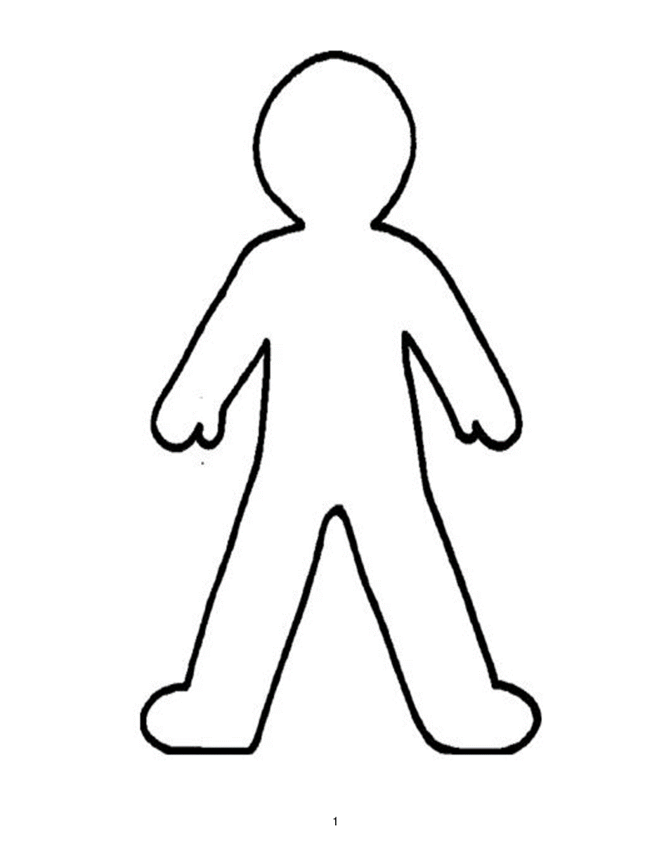
What are brave children like?
They don’t want to look stupid,
vulnerable or weak
They can ask for help
They can stand up for what’s right even if it’s not popular
They feel embarrassment or shame
They call friends out when they’re wrong
They don’t want to fall out with friends
They can walk away from dangerous friends or bad situations
They want to be popular
They will have a go at things they find difficult and even if they can’t do it the first time, they can keep going
They feel afraid of failure
They make mistakes and get things wrong and sometimes hurt people
They take responsibility when they do something wrong

Slide 9
Authentic Self

Slide 10
Why do we want our children to be brave?
So they can ask for help when they are struggling.
So they can be safe.
So they can stand up for themselves, others and what is right.
So they can feel good about themselves
So they can be honest.
So they can take responsibility when they have done something wrong.

Slide 11
When we want our children to be brave, we need to…

Slide 12
When we want our children to be brave, we need to…
Pink elephant
Share technique
Point out success
Praise
Cuddle
Model bravery
Listen
Commiserate
Laugh off mistakes
Prop up
Share experience
Coax
Point out learning
Get advice from others
Encourage
Scaffold
Discuss
Support
Be present if needed
Share stories of own experiences of feeling fear and being brave

Slide 13
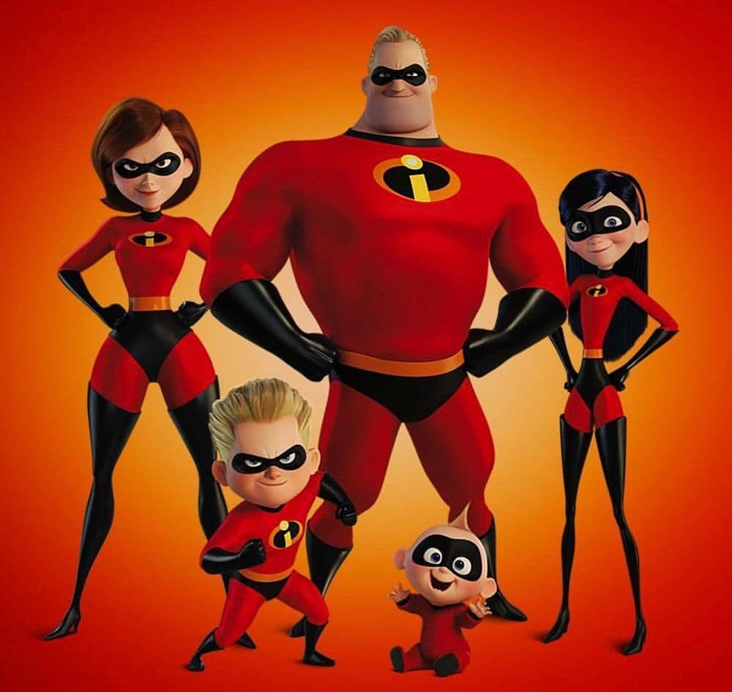
What do adults do to stop children being brave?
Not listen
Focus on justice or even revenge rather than a good outcome for everyone
Compare children to their siblings or to other children
Model the behaviour you don’t want – eg: being a keyboard warrior (aggressive or passive aggressive)
Be overly critical of their choices, beliefs, ideas, friends, clothing, etc
Not allow children to take any responsibility for things they did wrong
OR - make the child take too much responsibility for something they did wrong
Not allow the children a chance to try and sort things out themselves first
Not allow the children to take risks or even fail
Humiliation and put downs such as lgbtqi+, particular professions, etc

Slide 14
What can adults do to help children be brave?
Listen
Focus on a good outcome for everyone rather than tit for tat
Point out to children when they are being brave and praise them
Model the behaviour you want – eg: being hilariously funny or forgiving or dignified
Be interested in their choices, beliefs, ideas, friends, clothing, etc
Allow children a chance to try and sort things out themselves first and support from the back benches
Allow children to take responsibility for things they did wrong and allow them to feel it and understand it
But…
Don’t over-punish for mistakes – one mistake, one consequence
Allow children to take risks or even fail
Showing interest and learning more about things like lgbtqi+ or BLM and other movements

Slide 15
Summary of Bravery
Being brave is not a single event, it is a process
Being brave is a lifelong skill that requires practice
People can help us to be brave – we can be brave on our own but we can also be brave with support and back up
Plans and strategies can help us be brave
Being our authentic self is really important and it can also make us feel vulnerable and opens us up to criticism, shame and rejection. Being brave helps us to be our authentic self and expose our vulnerabilities regardless.

Slide 16
Useful Links
Power Poses - https://www.youtube.com/watch?v=IJrcJUV8d20
Adolescent brain animation by Dan Siegel - https://www.youtube.com/watch?v=0O1u5OEc5eY
Vulnerability - https://www.ted.com/talks/brene_brown_the_power_of_vulnerability
Character Matters by Graham Goulden - https://www.youtube.com/watch?v=-ky8JbmHSqY&feature=youtu.be&fbclid=IwAR2CFW_HhApg7u8fFI3gC3fddtjMrAuvByKjhDDxJaXhg4nrUzeOHGYZ8tE
Why are some people brave - https://www.pbs.org/newshour/science/why-some-people-are-willing-to-challenge-bad-behavior-despite-personal-risk?fbclid=IwAR1IXpAKJvPjMwlY8sQ88SGPLvkcB41VaA8LvAvK7hR6Abw5QIlSNsYjgyI
What makes a hero - https://www.ted.com/talks/matthew_winkler_what_makes_a_hero?language=en&fbclid=IwAR17k0w4dpRTdirV76yhT8_hSrk3bStB5WvkVCiMuy5OQeX1VZbNSP_v_gc

Slide 17
More useful links
https://mindfullittles.org/five-books-about-courage/

