Slide 1


Faculty of English & Literacy
Parent Council
Tuesday 3rd November 2020
Learning Together; Achieving Together Ambitious • Responsible • Resilient • Compassionate

Slide 2
COVID 19
SQA
National 5
N5 alternative certification arrangements:
Range of evidence
Assessment conditions
Moderated
Higher
Exam format unchanged (70% of award)
Writing Folio – reduced to 1 piece (30% of award)
Advanced Higher
Exam format unchanged (40% of award)
Dissertation unchanged (30% of award)
Writing Folio – reduced to 1 piece (30% award)
Health & Safety
Following whole school mitigations – sanitising stations, face coverings, seating plans etc.
Texts
Health & safety – cannot share books
Consistency – absence (pupils and staff)
Focus on skills required for success
All NQ classes study the same texts this session:
  Critical Essay – short stories
  Scottish Text – poetry
BGE – longer text in January – March term.
Google Classroom
Teaching resources used in class shared on GC.
All HW set as assignments – pupils unable to attend school can submit work/keep in touch with their teacher.
Learning Together; Achieving Together Ambitious • Responsible • Resilient • Compassionate

Slide 3
SQA Highlights
National 5
5% increase in number of pupils achieving A- C at N5 since 2018 – 93%
Increasing numbers of pupils presented at N5 in S4.
Higher
13% increase in number of pupils achieving A-C at Higher since 2018 – 90%
Increase in number of pupils achieving A/B grade – 65%
% of No Awards has decreased significantly (3%)
Advanced Higher
2019/20 – largest ever class
100% A-D
76% achieving A/B grade
Learning Together; Achieving Together Ambitious • Responsible • Resilient • Compassionate

Slide 4
Highest Quality Teaching & Learning
Incorporated whole school T&L priorities into dept. units:
  Learning Intentions & Success Criteria – differentiated
  Focus on feedback
  Retrieval Practice
Development of units in BGE – biography, introduction to Shakespeare, poetry.
Introduction of S2 Literacy Electives – debating, advertising, journalism, food in literature, graphic novels. Allows for pupil choice and ownership of learning.
Expanded study support opportunities – Study Success Club, Writing Folio support, RUAE workshops, Easter study sessions.
Prior to lockdown, using Google Classroom with all Higher classes to share resources and support learning.
Learning Together; Achieving Together Ambitious • Responsible • Resilient • Compassionate

Slide 5
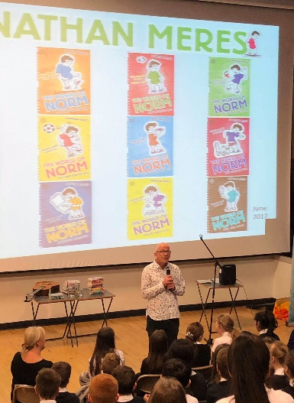
Building community
Family Literacy Events – partnership with Loch Leven Community Library
  Focus on supporting reading for pleasure
  Develop event as part of transition
Partnership with LLCL:
  S1 monthly library book talks
  S1/2 author visits
  S3 creative writing workshops
  AH creative writing
Refreshed Primary 7 transition in session 2018/19:
  Focus on importance of reading
Learning Together; Achieving Together Ambitious • Responsible • Resilient • Compassionate

Slide 6
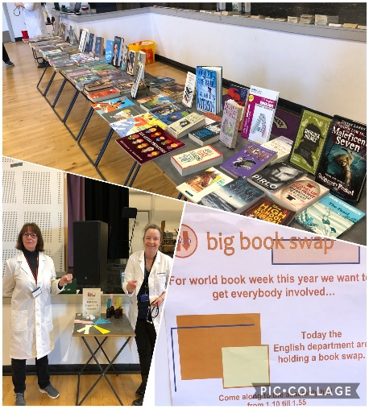
Unlocking leadership
Introduction of Literacy Leaders:
  Book Week Assemblies
  Transition Activities
  KHS Big Book Swap
S6 Paired Reading Supporters
  Supporting S1 pupils with reading
Staff within the department taking forward improvement priorities.
Learning Together; Achieving Together Ambitious • Responsible • Resilient • Compassionate

Slide 7

Literacy Across Learning
Literacy across the curriculum:
  Literacy 5-a-day Correction Code
  Staff BGE writing moderation session
  Share good practice
Reading Culture
  This week I am reading…
  First Minister’s Reading Challenge – TSG reading together
  Book Week Scotland activities
  KHS Book Swap
Learning Together; Achieving Together Ambitious • Responsible • Resilient • Compassionate

Slide 8
Looking Forward
School Recovery
Adapting SQA arrangements
Review BGE courses:
  Diversity in texts?
Developing a reading culture:
  Patron of reading
  Reading interventions
Learning Together; Achieving Together Ambitious • Responsible • Resilient • Compassionate

